Slide 1

IMPLEMENTATION OF FACE MASK DETECTION USING OPENCVN NON-FADING (AWGN) AND FADING (RAYLEIGH)
Presentation
By
Perabathula Vamshi Krishna [187Y1A0451]
Maddi Nikitha [187Y1A0422]
Under the Guidance of
E. SREENIVASULU
Associate Professor
Department of ECE
Department of Electronics and Communication Engineering

Slide 2

CONTENTS
MLRS
Abstract
Tools/Components using
Literature / Existing methods
Methodology / Implementation
Work done so far
Outcomes
Conclusion
References
Department of ECE
2

Slide 3
Abstract
MLRS
COVID-19 pandemic has rapidly increased health crises globally and is affecting our day-to-day lifestyle.
A motive for survival recommendations is to wear a safe facemask, stay protected against the transmission of coronavirus.
By wearing a facemask, the most effective preventive care must be taken against COVID-19.
Monitoring manually if the individuals are wearing face mask correctly and to notify the victim in public and crowded areas is a difficult task.
This project approaches a simplified way to achieve facemask detection and notifying the individual if not wearing facemask. The system runs in real-time and detects if an individual face has facemask if not then notifies the person-in-charge that the individual has not been equipped with mask.
Department of ECE
3

Slide 4
Tools/Components using
MLRS
Software used :
Python 3
Jupyter Notebook
Hardware Requirements:
Desktop/Laptop having minimum 200GB hard disk.
i3 processor or above.
Minimum 4GB RAM.
Department of ECE
4

Slide 5
Literature Survey
MLRS
Face mask detection refers to detect whether a person is wearing a mask or not. In fact, the problem is reverse engineering of face detection where the face is detected using different machine learning algorithms for the purpose of security, authentication and surveillance(J Biomed Inform. 2021 Jun 24).
A facial recognition system is becoming a very popular method at many airports and border controls around the world. The US Department of Homeland Security reported that facial recognition procedures would be used on almost 97% of travelers by 2023(Mira M. Boulos 2021 May ).
This system consists of a dual-stage (CNN)architecture capable of detecting masked and unmasked faces and can be integrated with pre-installed CCTV cameras. This will help track safety violations, promote the use of face masks and ensure a safe working environment(R. Suganthalakshmi 2021 March 27)..
Department of ECE
5

Slide 6
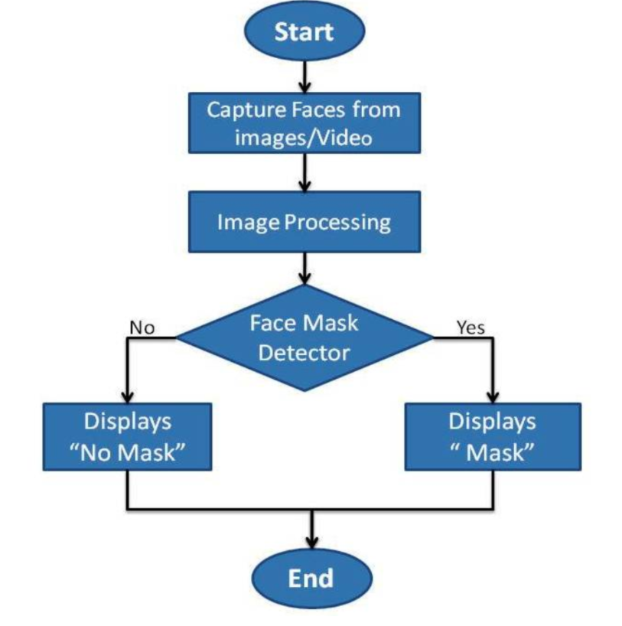
Methodology / Implementation
MLRS
Department of ECE
6

Slide 7
MLRS
The project will have these important phases:
Module 1: Collection of Data:
The proposed system uses data containing images with different angles and different poses of face with and without masks.
Module 2: Faces Detection - Image processing:
The main function of Image processing in our project is to detect faces with or without mask. This process is done during the training phase as well as during real-time detection.
Module 3: Training the Model with Data:
In the proposed system the custom dataset will be loaded and will be trained based on labelled images. Here we’re using Supervised Machine learning for training the model. Under Supervised Learning, there are different sub categories like - Regression, Classification, Clustering etc. Here we are using Classification with the data collected with and without masks, which is properly preprocessed.
Department of ECE
7

Slide 8
MLRS
Module 4: Real-Time Detection:
Our system works in a automated manner. When an image frame is captured, image processing is performed to detect faces in it. Then those faces are classified as with or without masks using Machine Learning. We get the result in the same frame with a square box around the faces and label saying with a mask or without mask.
Module 5: Implementing the Model:
Our system uses a custom dataset with the input video taken from any camera device. The system feeds with a real time video in public places which automatically monitors and detects whether people are wearing face masks or not.
Department of ECE
8

Slide 9
Work done so far
MLRS
The working process of the project till now:
For implementing the face detection basically we need some data where they are called as data sets,in which the images of faces are stored and retrieved while simulation for image processing.
The basic steps of face mask detection is the base level is to collect the datasets of face images and create a cascade file .
The Viola-Jones algorithm is used in this project because there is no need to store separate data of image sets to train the data, when the program executes the data sets of images are automatically taken of the user and trained itself.
CNN method is faster than other methods, where this is used to take an input image and assign its importance of weights and biases.
Now, we are going to implement this total process in jupyter notebook using Python3..
Department of ECE
9

Slide 10
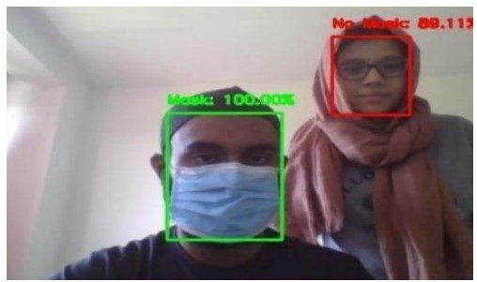
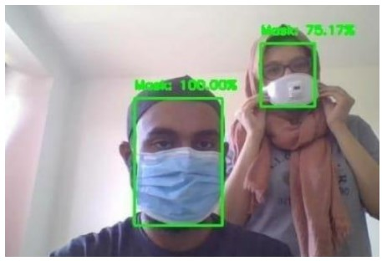
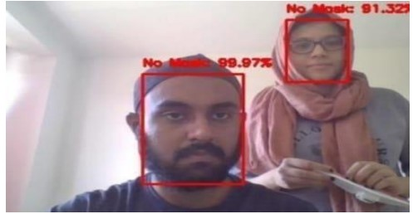
Outcomes
MLRS
Department of ECE
10

Slide 11
Conclusion
MLRS
Conclusions:
People are advised to wear face mask everywhere because the pandemic is not yet over.
So that this can used everywhere, it detects that people are wearing mask or not.
It also informs higher authorities whether a person is not detected without wearing face mask.
We have studied how to load an image for the implementation and also how to detect faces using open cv functions.
By the development of face mask detection we can detect if the person is wearing a face mask and allow their entry would be of great help to the society. The accuracy of the model will be achieved and the optimization of the model is a continuous process and So we are building a highly accurate solution. We can prevent peoples from Virus Transmission through this System.
Department of ECE
11

Slide 12
References
MLRS
[1]. Face Mask Detection Using OpenCV in Python by Brain Mentors Pvt Ltd. Ref:
https://brain-mentors.com/face-mask-detection-using-opencv-in-python/
[2]. Suresh K, Palangappa MB, Bhuvan S : “ Face Mask Detection by using Optimistic Convolutional Neural Network “ at
International Conference on Inventive Computation Technologies [ICICT 2021]
[3]. Yadav S. “Deep learning based safe social distancing and facemask detection in public areas for COVID-19 safety guidelines adherence.” Int J Res Appl Sci Eng Technol. 2020;8(7):1368-1375.
[4]. S, Akshay & Bhat, Mandara & Rao, Aishwarya. (2019). “Facial Expression Recognition using Compressed Images.” International Journal of Recent Technology and Engineering. DOI:10.35940/ijrte.B1041.078219.
[5]. Loey M, Manogaran G, Taha MHN, Khalifa NEM. “A hybrid deep transfer learning model with machine learning methods for face mask detection in the era of the COVID-19 pandemic.”
Measurement (Lond). 2021;167:108288.
Department of ECE
12

Slide 13

MLRS
Department of ECE
13

